Slide 1
Sequence models: Recurrent Neural Networks, LSTM, GRU
Luke

Slide 2
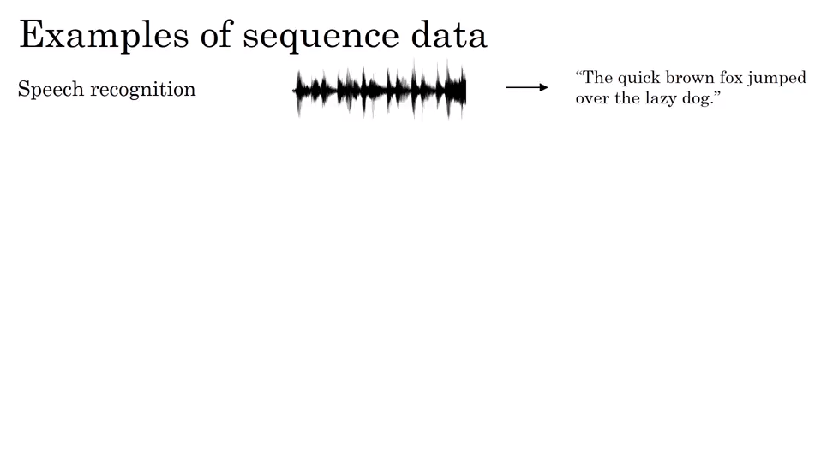
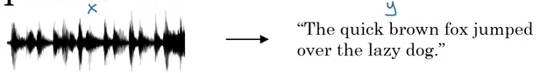
What is a sequence?

Slide 3
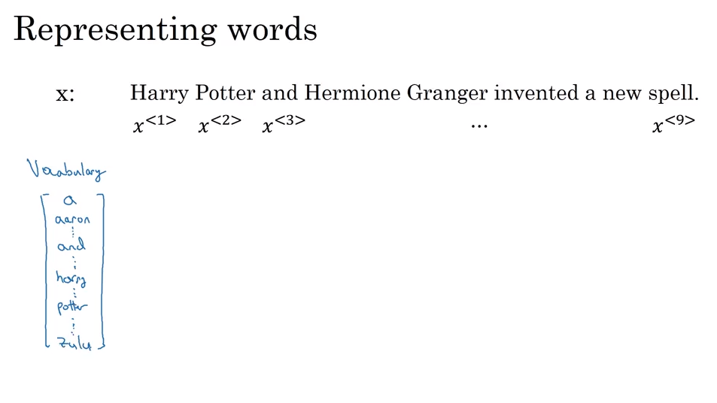
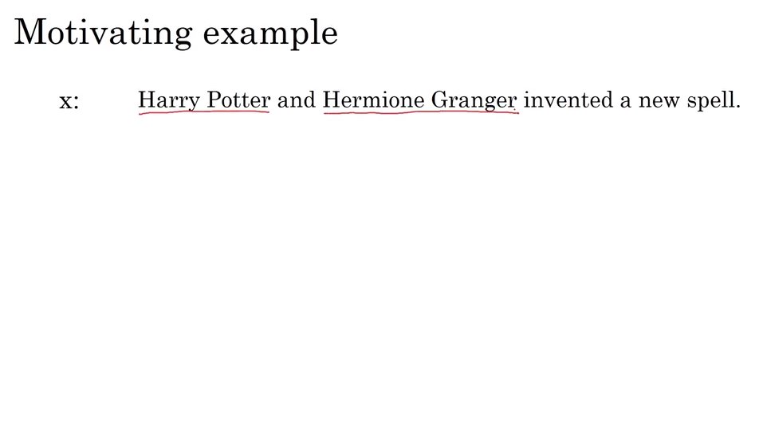
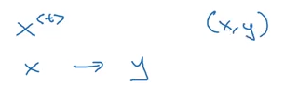
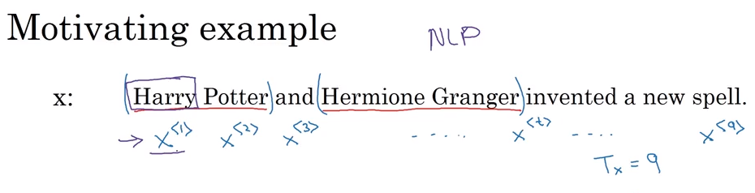
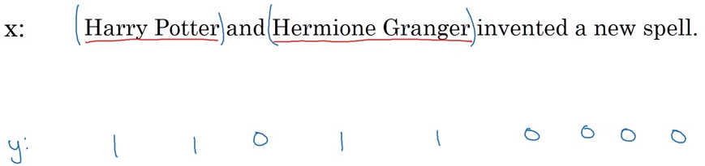
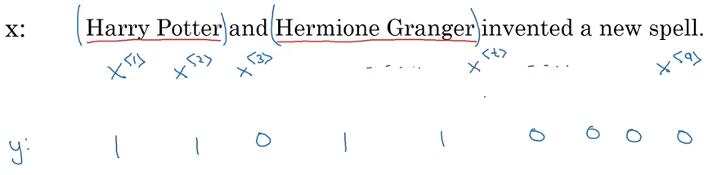
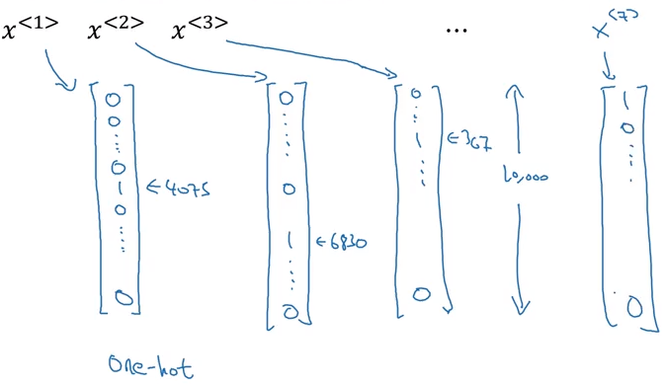
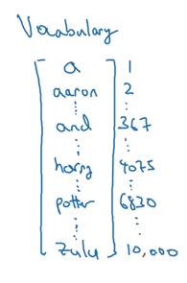
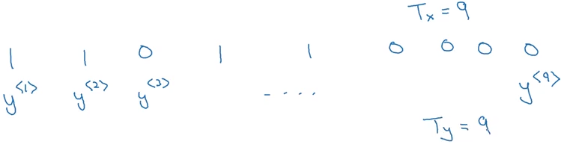
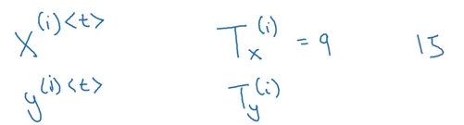
notation
30,000 ~ 100,000 ~ 1,000,000 = Google
dictionary
<UNK>

Slide 4
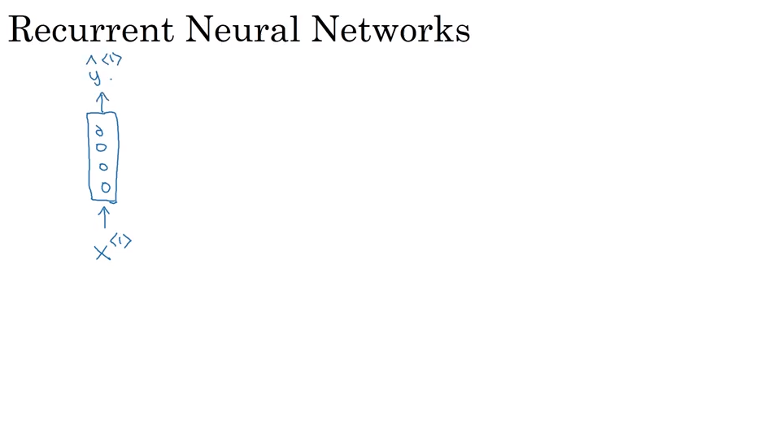
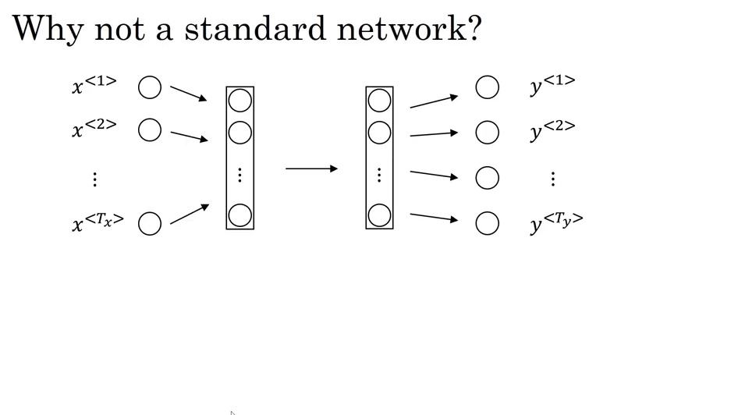
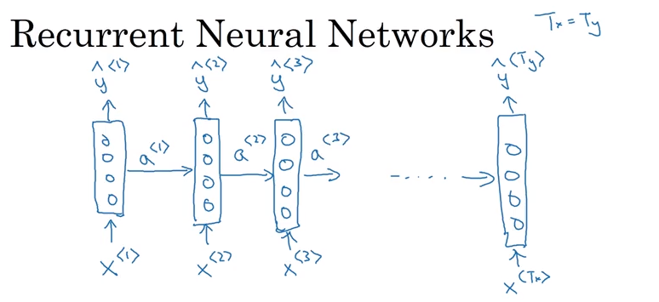
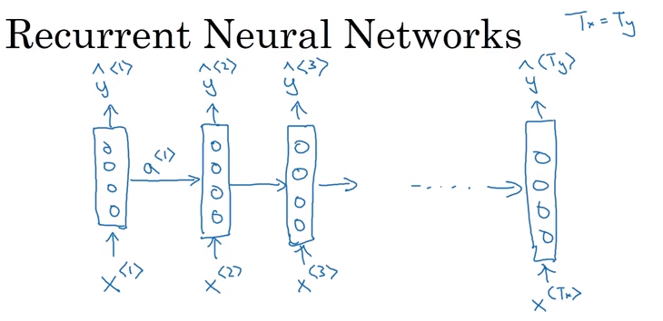
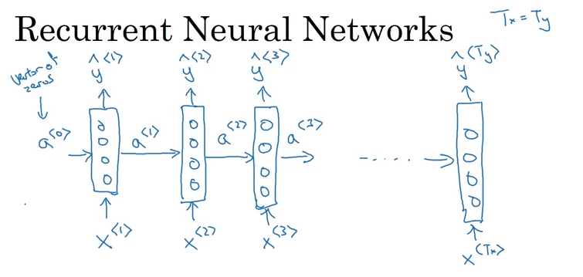
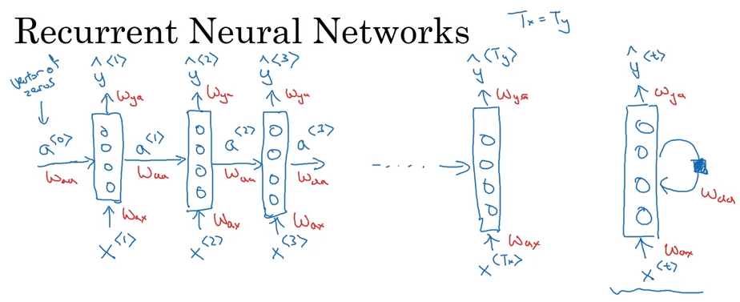
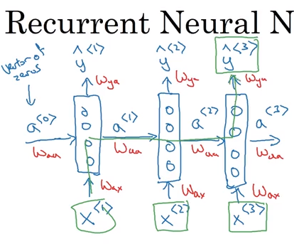
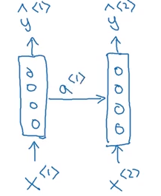
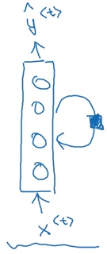
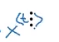
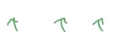
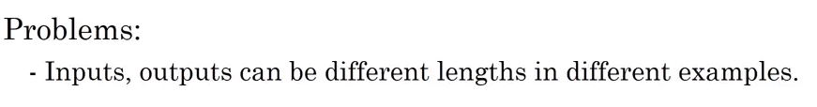
Building an rnn
Too many parameters!
Bidirection Recurrent NNs (BRNN)
He said, “Teddy Roosevelt was a great president.”
Vs
He said, “Teddy bears are on sale.”

Slide 5
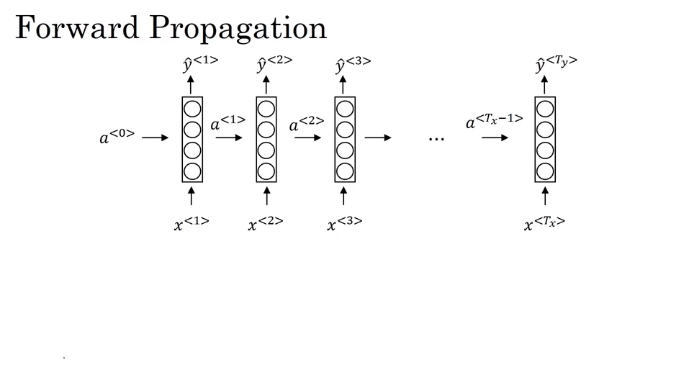
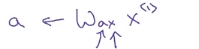
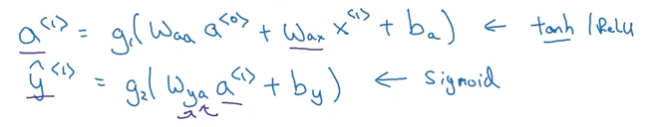
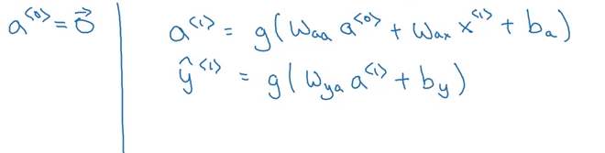
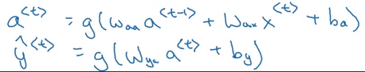
Rnn computation
Or softmax

Slide 6
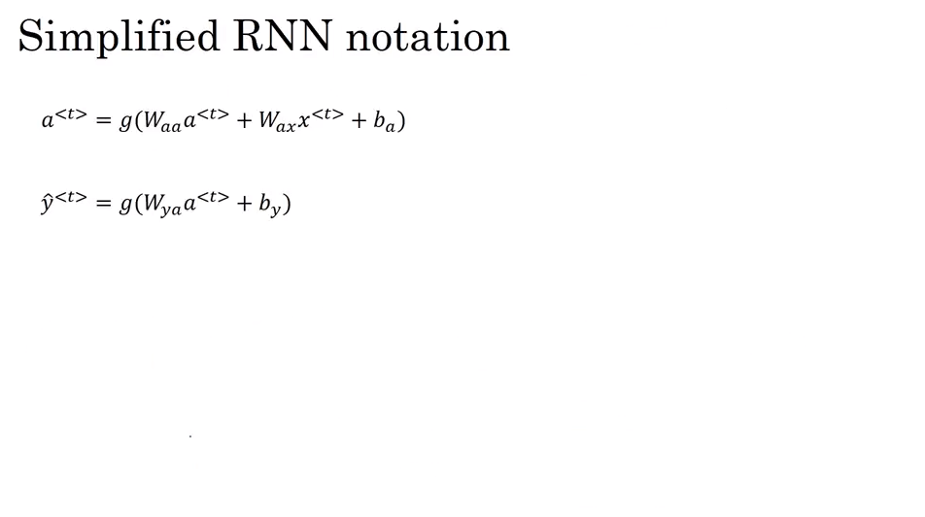
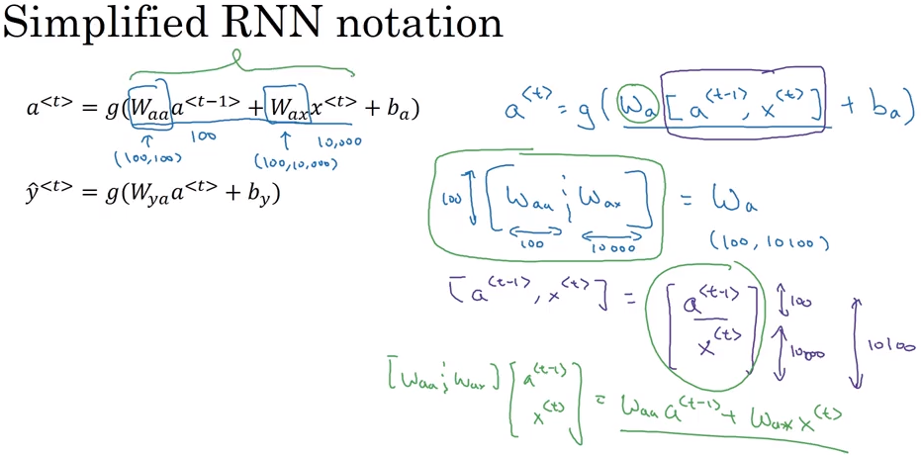
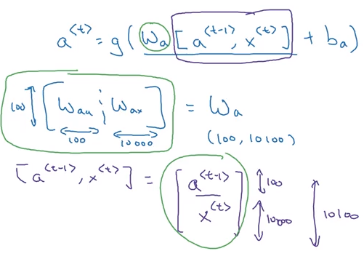
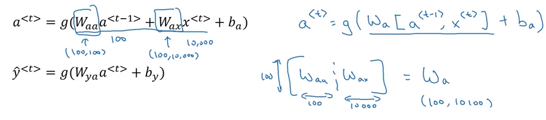
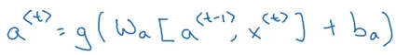
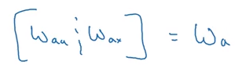
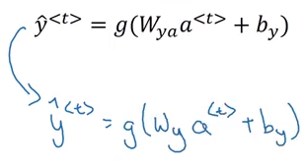
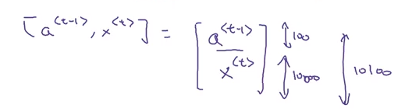
Equation simplficiation

Slide 7
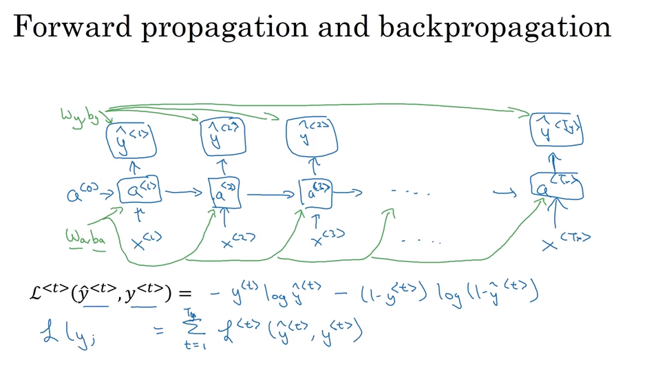
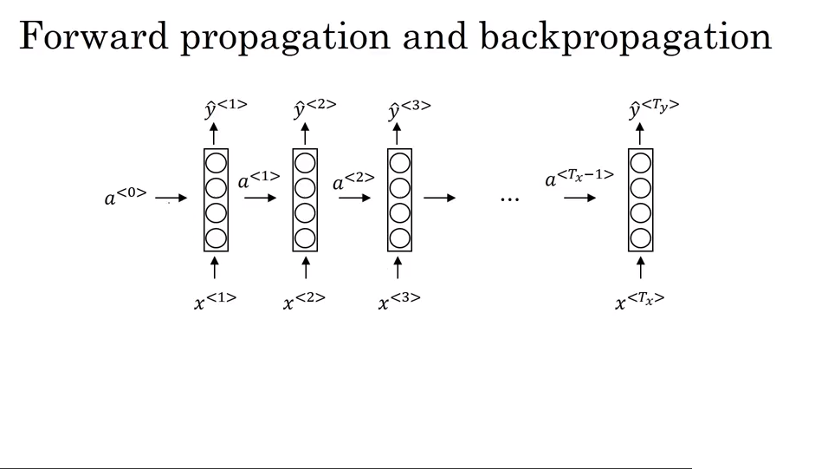
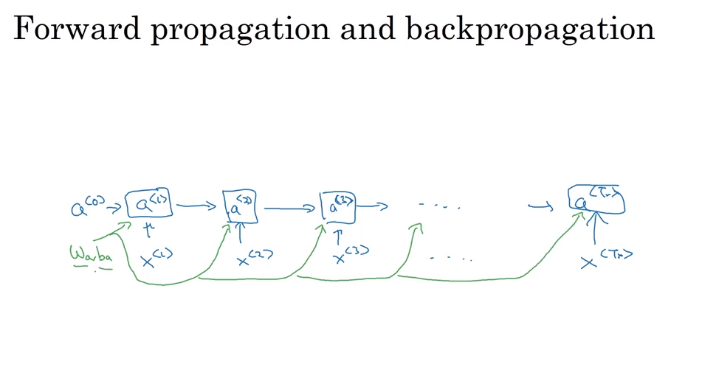
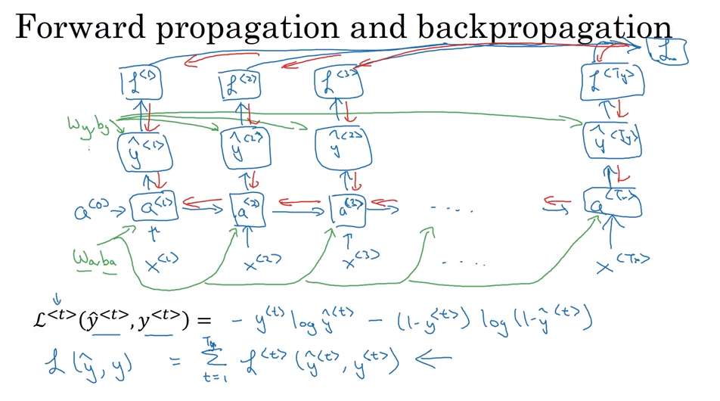
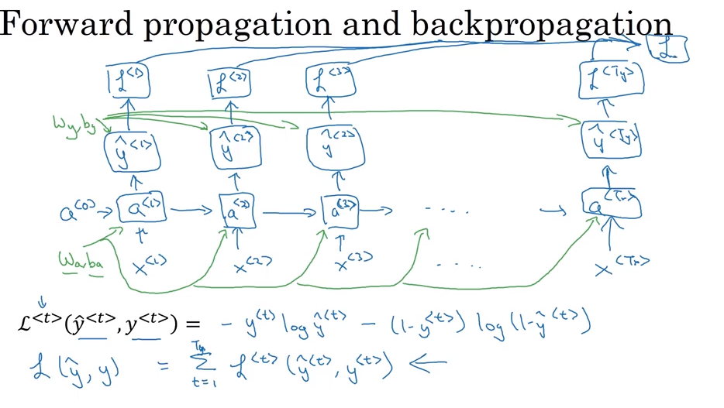
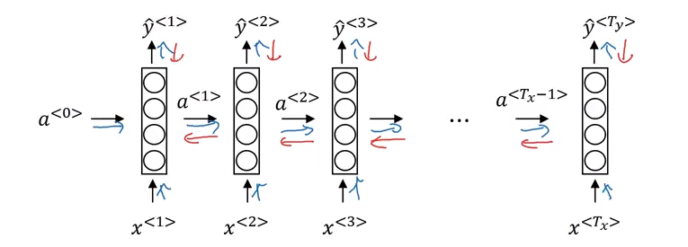
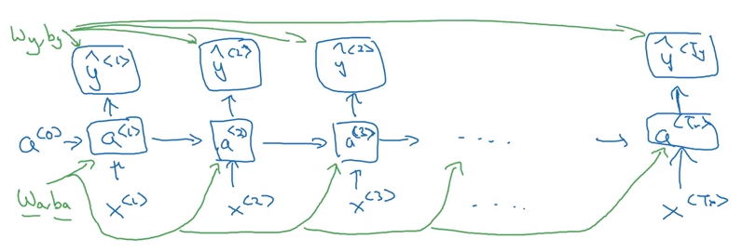
Backpropagating through time
Backpropagation through time

Slide 8
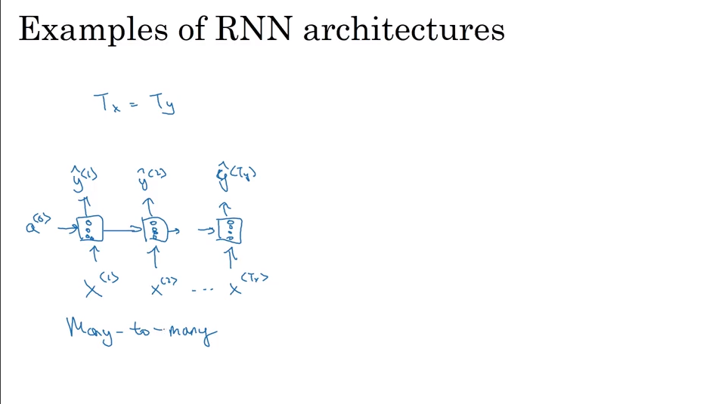
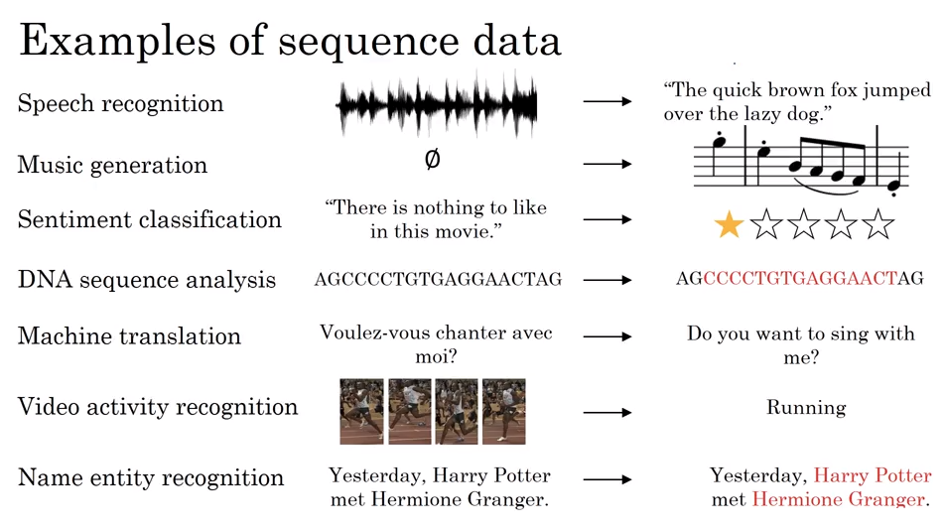
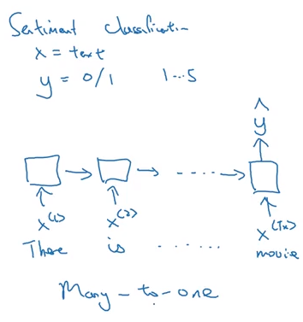
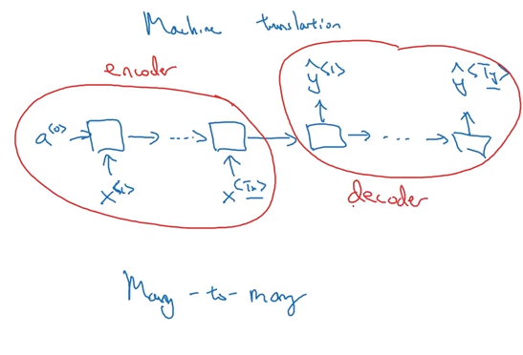
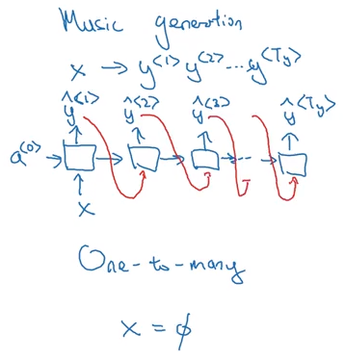
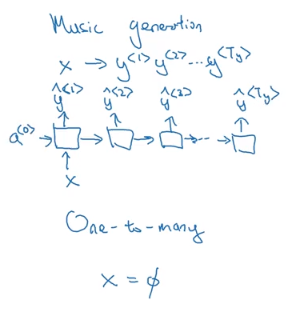

Rnn of a different color

Slide 9















Sequence generation
P(a) P(aaron) … P(cats) … P(zulu)… P(<UNK>) P(<EOS>)
The Egyptian Mau is a breed of cat. <EOS> (10,000)

Slide 10







Sample novel sequences
No UNK problem, but huuuuuuuge
Sequences – long range dependences
P(___| “The”)
End of sequence?
<EOS> or
Time step selection
<UNK>
The air condition in building 310, which serves as the headquarters of the CDLC, doesn’t work.
Notes:
http://konlpy.org/en/v0.4.4/examples/generate/

Slide 11






Vanishing gradients in rnns
Simple RNN model
Struggles with long-
distance dependencies
Because of local
influences
Exploding gradients! --- NaN --- gradient clipping – rescale to some threshold

Slide 12


















Gated recurrent units (GRU)
Notes:
https://stackoverflow.com/questions/40761185/what-is-the-intuition-of-using-tanh-in-lstm
https://cs224d.stanford.edu/lectures/CS224d-Lecture6.pdf

Slide 13









Long short term memory (LSTM) unit

Slide 14








Bidirectional rnns (brnn)
BRNN + LSTM = commonplace in NLP
This is forward propagation in both directions – NOT BACKPROP

Slide 15






Deep rnns

Slide 16

How do computers see?

